Slide 1
Introduction to Statistics for Ecology and Evolutionary Biology Model Selection Week 14 13 December 2021

Slide 2
The Dangers of Overfitting, Model Comparison, “How Do I Choose What Goes Into My Model?”, and Some Other Related Stuff

Slide 3
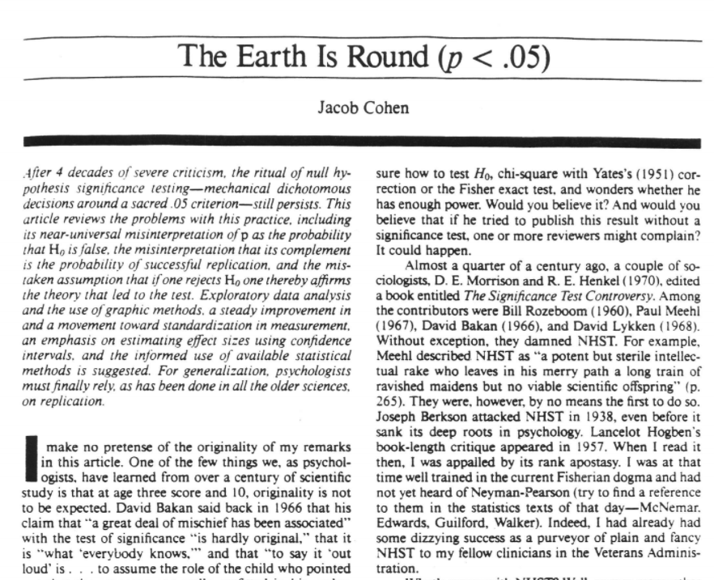
On the insignificance of significance testing
What we want to know:
Given these data, what is the probability that our null hypothesis is true?
What null hypothesis significance testing does:
Given that the null hypothesis is true, what is the probability of these data?
Cohen 1994, American Psychologist

Slide 4
p-values are (most often) useless
Model outcome
p<0.05
p>=0.05
Sample size
Sample size
Small
Large
Small
Large
Effect size very large
Effect size may be very small
Effect size not large enough
Effect size very small
No statistical test needed
Is the effect meaningful?
Effect may still be meaningful
No statistical test needed

Slide 5
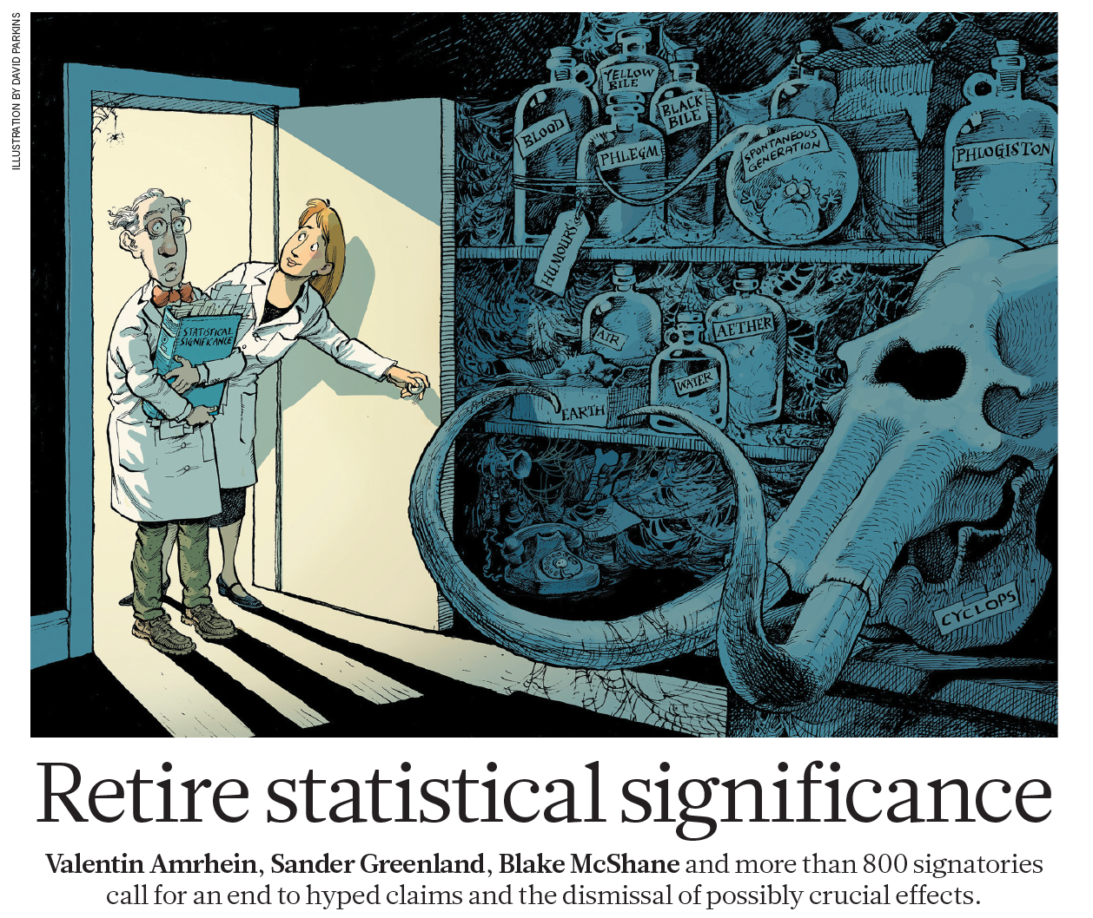
Statistical Norms: Open for Debate
Amrhein et al. 2019, Nature

Slide 6
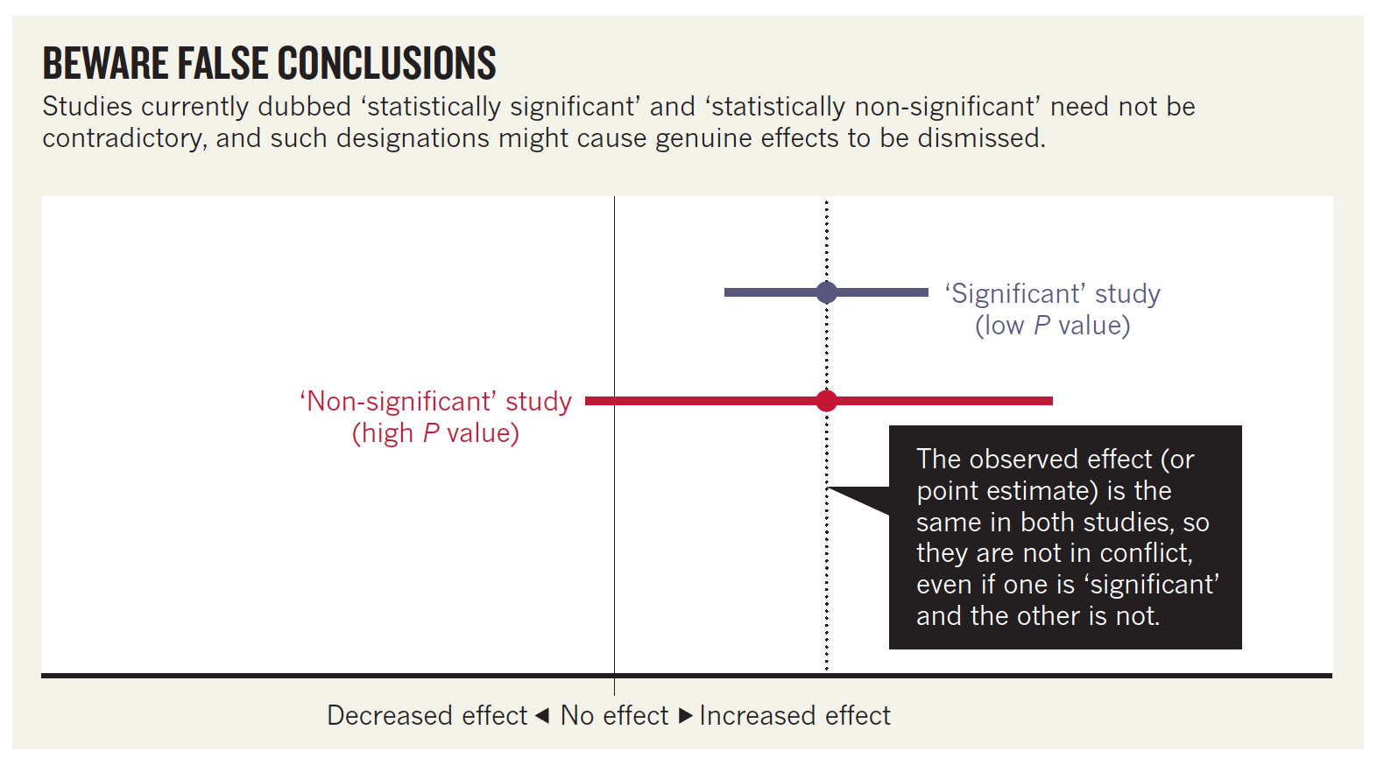
Statistical Norms: Open for Debate
Amrhein et al. 2019, Nature
Notes:
Note that this article encourages careful interpretation of parameter estimates (i.e., point estimates or effect sizes) rather than dichotomization into significant and non-significant results

Slide 7
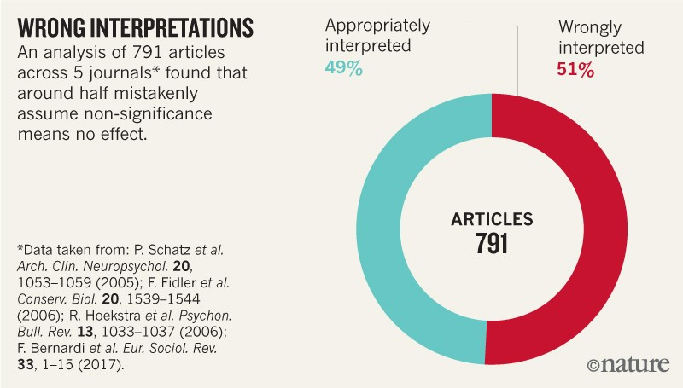
Statistical Norms: Open for Debate
Amrhein et al. 2019, Nature
Notes:
Note that this article encourages careful interpretation of parameter estimates (i.e., point estimates or effect sizes) rather than dichotomization into significant and non-significant results

Slide 8
Overfitting / Underfitting
The problem with learning too much or too little from your models

Slide 9
Complexity in Ecology
“Ecology would be easy, were it not for all the ecosystems—vastly complex and variable as they are … Scientists like to impose structure and order on chaos, and ecologists are no different. Ecology has its grand theories, but they are riddled with conditional clauses, caveats and exceptions … It is doubtful that the generalities that underlie the complex patterns of nature will ever be phrased succinctly enough to fit on a T-shirt.”
Editorial 13 March 2014, Nature

Slide 10
The Problem with (Too Few) Parameters
Ockham’s razor is a heuristic stating that simpler theories are to be preferred to more complex ones
This would imply we might choose simpler models
However, models differ not only in complexity but also accuracy, and ideally we want to balance these competing model characteristics
Notes:
William of Ockham was a medieval philosopher
Note, this is “razor” in the philosophical sense of a simplifying principle
https://www.britannica.com/topic/Occams-razor/media/424706/194403

Slide 11
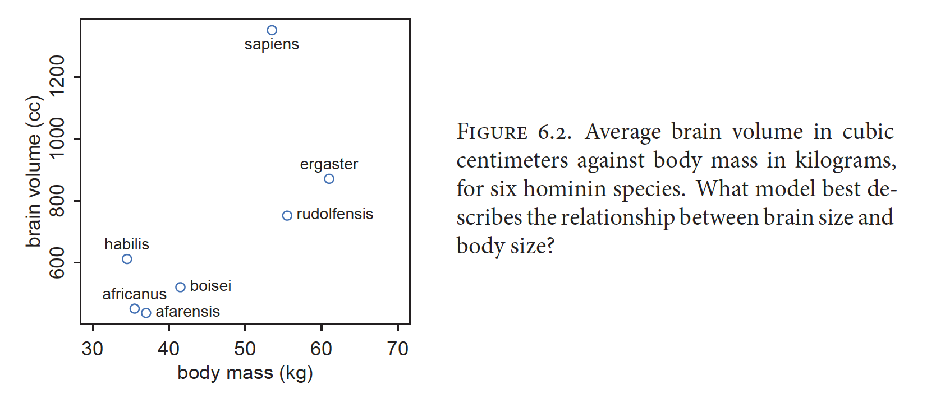
The Problem with (Too Many) Parameters
McElreath 2016, Statistical Rethinking
Notes:
A strategy to illustrate the problem with parameters is to fit this same dataset with increasingly complex models

Slide 12
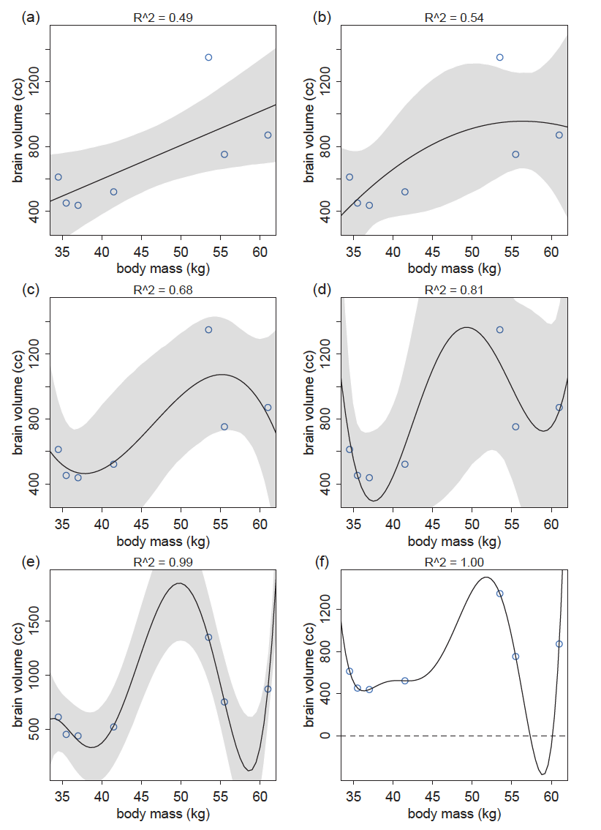
Notes:
R^2 is used here as a measure of model fit to the observed data
Note the model in the lower right corner has a perfect fit to the observed data, but the predictions (i.e., negative values) are clearly problematic
This is a primary problem with parameters: overfitting
“Overfitting occurs when a model learns too much from a sample.”

Slide 13
The Problem with (Too Many) Parameters
If predictor variables suffer from multicollinearity then adding parameters can hurt overall inference (as we saw in a previous lecture)
Moreover, adding parameters nearly always improves the fit of the model to the observed data
Yet more complex models often fit new data worse
In other words, they do not perform well out-of-sample
Out-of-sample prediction is usually (at least implicitly) what we actually care about!

Slide 14
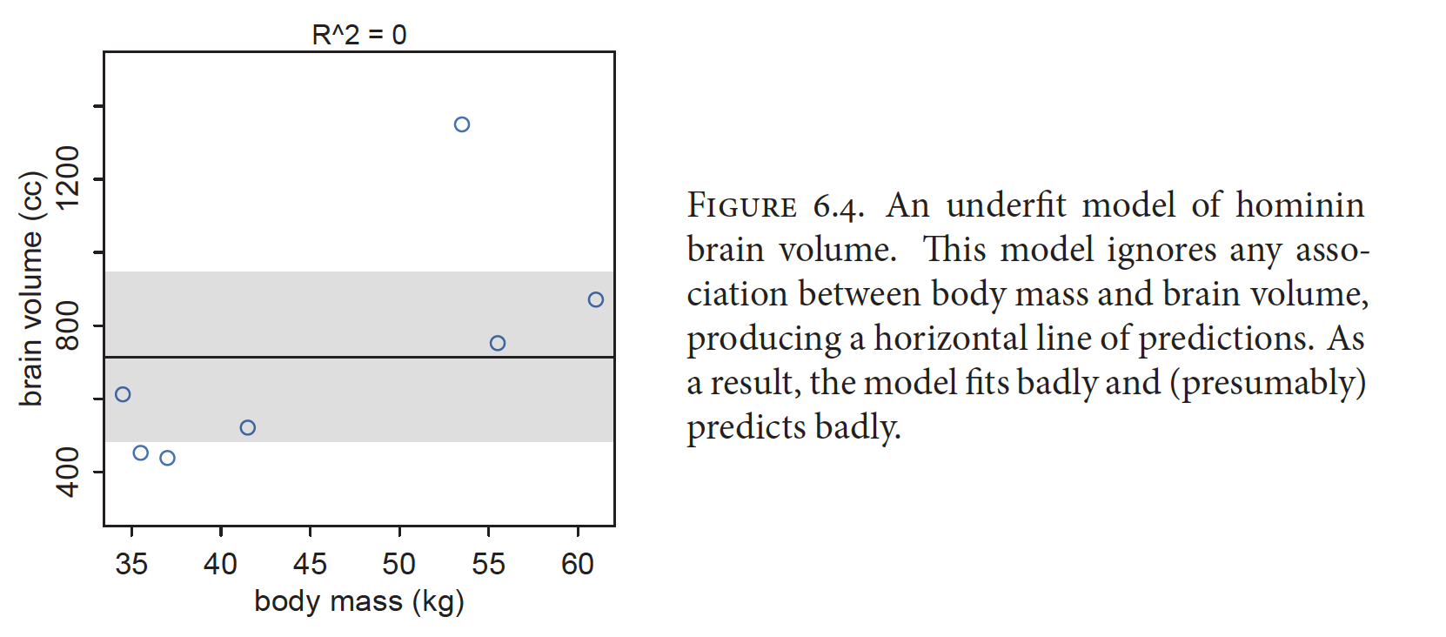
The Problem with (Too Few) Parameters
McElreath 2016, Statistical Rethinking
Notes:
In contrast, a model with too few parameters will underfit the data
One way to think of it:
When we underfit we learn too little from the data
When we overfit we learn too much from the data
Overall, this suggests we’d like to build models that balance the dangers of overfitting and underfitting

Slide 15
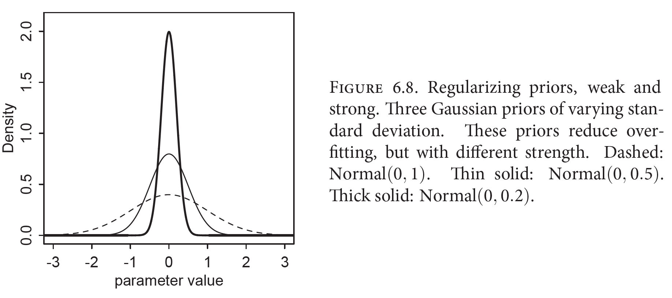
Combatting Overfitting: Regularization
A skeptical prior applied to the “slope” parameter of a linear model, which induces conservativism
McElreath 2016, Statistical Rethinking

Slide 16
Ridge and Lasso Regression
Ridge regression is a linear modeling strategy with penalized slope coefficient estimates
Consequently, slope parameter estimates are regularized
Lasso regression is a linear modeling strategy with penalized slope coefficient estimates in which some coefficients are set to zero
Consequently, slope parameter estimates are regularized and some are selected in or out of the model
A form of variable selection (i.e., choosing variables to use in model construction and interpretation)

Slide 17
Out-of-sample predictive accuracy
Cross-validation
Training on subset of data, testing on held-out data
K-fold: divide data into k folds, predict one with model trained on all others, then average accuracy across all folds
Leave-one-out: remove only 1 observation from each fold, default in cv_quap() function
Pareto-smoothed importance sampling (PSIS)
Unlikely observations indicate poor out-of-sample accuracy without having to do CV
Estimate pareto distribution for each observation
k as a measure of shape, larger k indicates greater influence on prediction

Slide 18
Out-of-sample predictive accuracy
Information-criteria
Calculates expected score out-of-sample
Derived from the information entropy of a given distribution and its divergence from a hypothetical “true” distribution
NOTE: Absolute divergence from the “true” distribution is inaccessible because the truth is unknown. All we can estimate are differences in relative divergence between competing models

Slide 19
Combatting Overfitting: Information Criterion
Hirotugu Akaike
Akaike’s Information Criterion (AIC)
Notes:
https://www.google.com/logos/doodles/2017/hirotugu-akaikes-90th-birthday-5767291382792192.3-2x.png

Slide 20
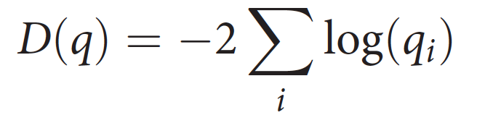
Model Deviance
Log-pointwise-predictive-density, calculated with lppd() function on any quap model
Read: Deviance is the sum of the average (!) log likelihood values (averaged over the posterior) for all cases in the data, multiplied by -2
Smaller values indicate better average predictive accuracy
Provides an approximation of divergence
And therefore serves as an assessment of relative model fit
Notes:
However, in-sample deviance will still decline with increasing model complexity (just like R^2 values)

Slide 21
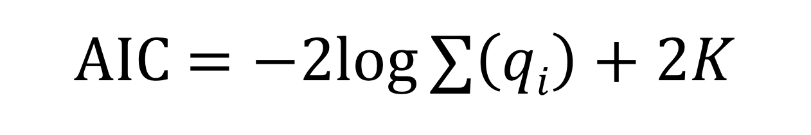
Akaike’s Information Criterion (AIC)
An estimate of out-of-sample deviance, and therefore a measure of predictive accuracy
Lower AIC scores are better
Models can only be compared relative to one another, and must be fit to the same data
AIC $=−2log∑\left(qi\right)+2K$
Model deviance:
Assesses fit
Penalization for parameters:
Controls complexity
Notes:
K = the number of parameters in the model

Slide 22
Combatting Overfitting: Information Criterion
Akaike’s Information Criterion (AIC)
Deviance defined at parameter MAP values
Works when the following conditions are met:
Priors are flat or overwhelmed by the likelihood
Posterior distribution is multivariate normal
Sample size is much greater than number of parameters

Slide 23
Combatting Overfitting: Information Criterion
Deviance Information Criterion (DIC)
Deviance measure incorporates posterior parameter uncertainty
Widely Applicable Information Criterion (WAIC)
Like the log-pointwise predictive-density calculated in cross-validation, but adds a penalty term for the variance of posterior predictions
WAIC() function for any quap model
Notes:
Crucial point: ALL of these are estimates of out-of-sample deviance, which is the target we want in judging models

Slide 24
(Mis)uses of Information Criterion
Stepwise selection uses addition/removal of predictor variables from the model and repeated model selection to find the “best” model
Can result in biased parameter estimation, inconsistent model selection, etc.

Slide 25
Consider the Curse of Tippecanoe
From 1840 – 1960, every US president elected in a year ending with 0 has died in office
Surprising patterns such as these can be found in almost any dataset if you look hard enough
Trying out many predictor variables is a good way to unearth such coincidences and risk interpreting them as meaningful patterns!
William Henry Harrison
Notes:
Stepwise selection and all subsets selection can make it relatively easy to be led astray by such patterns that are not founded in biology
“The biology and underlying science should drive the hypotheses and modeling” – Anderson and Burnham 2002
https://upload.wikimedia.org/wikipedia/commons/c/c5/William_Henry_Harrison_daguerreotype_edit.jpg

Slide 26
(Mis)uses of Information Criterion
Stepwise selection uses addition/removal of predictor variables from the model and repeated model selection to find the “best” model
Can result in biased parameter estimation, inconsistent model selection, etc.
All subsets selection compares a full (i.e., “global”) model containing all predictor variables of interest and all potential subsets of that model
“Use of all subsets regression is a flag that an unthinking approach has been employed.” - Anderson and Burnham 2002
Anderson and Burnham 2002, The Journal of Wildlife Management
Whittingham et al. 2006, Journal of Animal Ecology

Slide 27
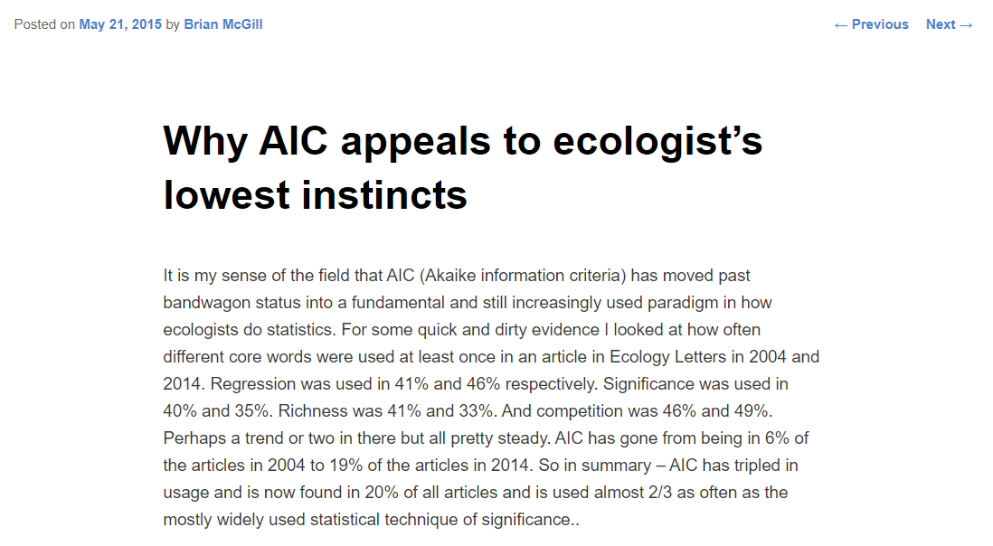
(Mis)uses of Information Criterion
Notes:
Dynamic Ecology post: AIC is appealing because it 1) reduces our thinking to one dimension and 2) ranks models

Slide 28
(Mis)uses of Information Criterion
"AIC as practiced is appealing to base human instincts to rank and to be wishy washy about inferential frameworks. There is NO philosophy of science that says ranking models is important. Its barely better than useless to science. And there is no philosophy of science that says you don’t have to be clear what your goal is.”
Brian McGill, U of Maine
Notes:
Dynamic Ecology post: AIC is appealing because it 1) reduces our thinking to one dimension and 2) ranks models
“Our goal is to tease apart the contributions of many processes, all of which we believe are affecting our study system to some degree. If our scientific question is (something like) “How important is this factor, in an absolute sense or relative to other factors?”, not “Which of these factors are actually doing anything at all in my system?”, why are we working so hard to fit many models of which only one (the full model) incorporates all of the factors? If we do not have particular, a priori discrete hypotheses (such as “A influences the outcome but B does not”) about our system (and a multifactorial approach would suggest that we should not), why does so much of our data-analytic effort go into various ways to test between, or combine and reconcile, multiple discrete models?” – Ben Bolker

Slide 29
Better Approaches
Model comparison and multi-model inference using a well-considered set of a priori models
In practice, many don’t use this approach to evaluate different hypotheses but rather to conduct an informal form of variable selection
Inference based on one well-considered full model
Most effective with larger amounts of data and can derive particular benefit from regularization

Slide 30
“The challenge is to begin with better science questions.” - Anderson and Burnham 2002 “As always, statistics is no substitute for science.” - McElreath 2016
Notes:
Statisticians are often the most skeptical about the inferential power of statistics

Slide 31
Course summary
A list of things you have achieved this semester!

Slide 32
Things you have learned about… Nobody expected you to learn everything there is about any of these!
Data manipulation and graphical exploratory analysis in R
Probability distributions
Point estimates (mean, median)
Null hypothesis significance testing and p-value
Bayesian logic: Prior * Likelihood = Posterior
Linear models for
Normally distributed measurement variables
Count data
Binary outcomes
Multiple regression
Categorical and continuous predictors
Assess and interpret interactions
Model comparisons

Slide 33
Suggested next steps
Dive deeper into generalized linear models
Learn about random slopes and intercepts
Stay Bayesian whenever you can
Get familiar with brms() package
Learn rstan
If forced to use non-Bayesian alternatives, don’t make inferences based on p-values!
Practice your data visualizations
Educate others

Slide 34

Goodbye and good luck!
Now go make a difference!

